Slide 1

Category Code: Open Innovation
Problem Statement Title: Empowering Women Through a Centralized Digital Platform
Team Name: $ git commit -m "issues"
Institute Name: Vivekanand Education Society’s Institute of Technology

Slide 2

Idea / Approach details (& implemented features)
Community Support
Financial
Independence
Health Tracking
Safety & Legal Assistance
Discussion forums for health, legal rights, and career growth offer a safe space with anonymous participation, ensuring privacy and fostering a sisterhood no generic platform can match.
AI-driven job matching and freelance gig listings tailor opportunities to women’s skills and dreams, redefining economic empowerment with unmatched precision.
Menstrual health tracking, self-defense resources, and mental health tools—designed for all tech levels—create a holistic, woman-focused wellness hub no other site rivals.
Anonymous domestic violence reporting, emergency alerts, and encrypted communication deliver unmatched safety and justice, protecting women with cutting-edge security.

Slide 3
Innovation (Showstopper)
Astitva stands out due to its all-in-one approach, combining safety, employment, health, and community support in a single platform tailored for women. Key innovative features include:
AI-Powered Chatbot
Job
Finder
Encrypted Privacy
Real-time Mapping
A job finder for women helps women discover job opportunities tailored to their skills, preferences, and work conditions (e.g., remote, part-time, women-friendly workplaces).
Provides instant, personalized responses to legal, health, and career queries, enhancing user support using RAG. Built with Gemini AI, uses NLP for 90% accurate responses to legal/health queries.
Secure communication ensure user safety and trust, critical for sensitive issues like domestic violence.
Features end-to-end encryption and IP masking, making it impossible to trace users even in high-risk situations.
Real-time mapping of essential resources, making help accessible even in urgent situations. OpenStreetMap integration pinpoints 200+ resources in 5 cities

Slide 4
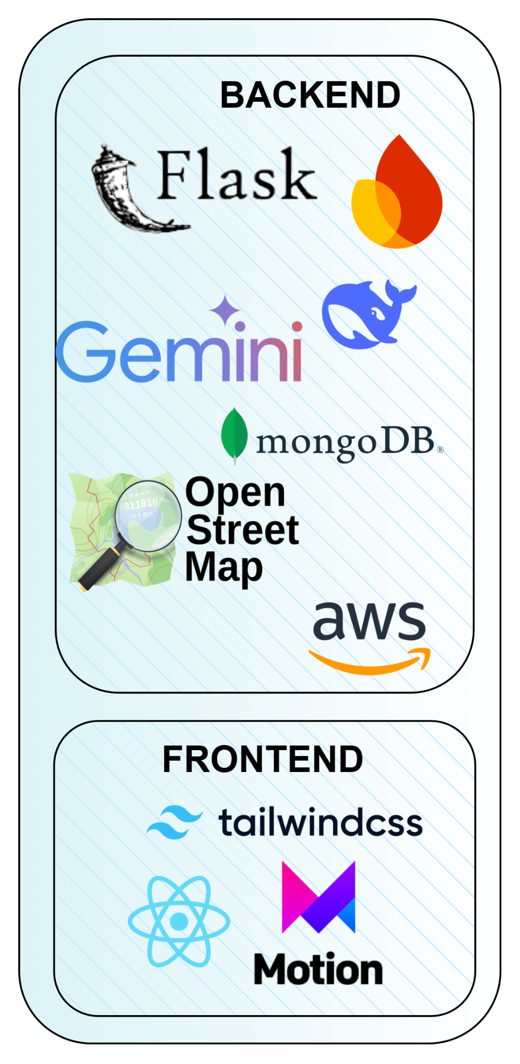
Tech Stack
🔹 Backend
Flask – Lightweight yet powerful, enabling rapid API development and seamless integration.
Gemini AI – Provides smart chatbot assistance for legal, health, and career-related queries.
MongoDB – NoSQL database ensuring flexible, scalable, and high-speed data storage.
OpenStreetMap – Enables real-time geolocation mapping for finding shelters, job centers, and medical facilities.
AWS – Cloud services for secure data storage, hosting, and high availability.
🔹 Frontend
React.js – Builds an interactive, dynamic, and scalable user experience.
Tailwind CSS – Provides a sleek, modern, and mobile-responsive UI.
Framer Motion – Adds smooth animations for an engaging and user-friendly interface.

Slide 5
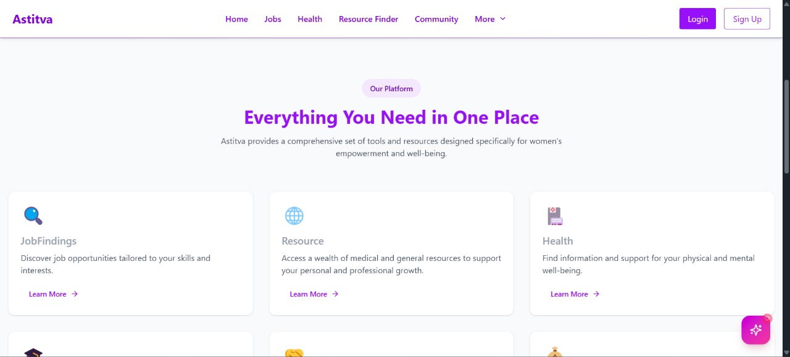
Implementation/Prototype/Use Case Diagram (screenshots)
This section of Astitva highlights its key features, offering job opportunities, medical and general resources, and health support to empower women.
The platform provides everything in one place for personal and professional growth.

Slide 6
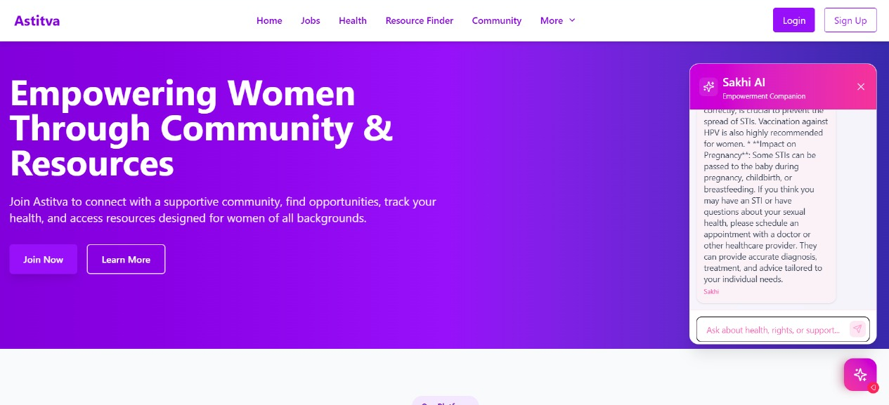
Implementation/Prototype/Use Case Diagram (screenshots)
This is the homepage of Astitva, an AI-driven platform for women's empowerment. It features community support, job opportunities, health tracking, and resource access.
A chatbot, Sakhi AI, provides guidance on health, rights, and support.

Slide 7
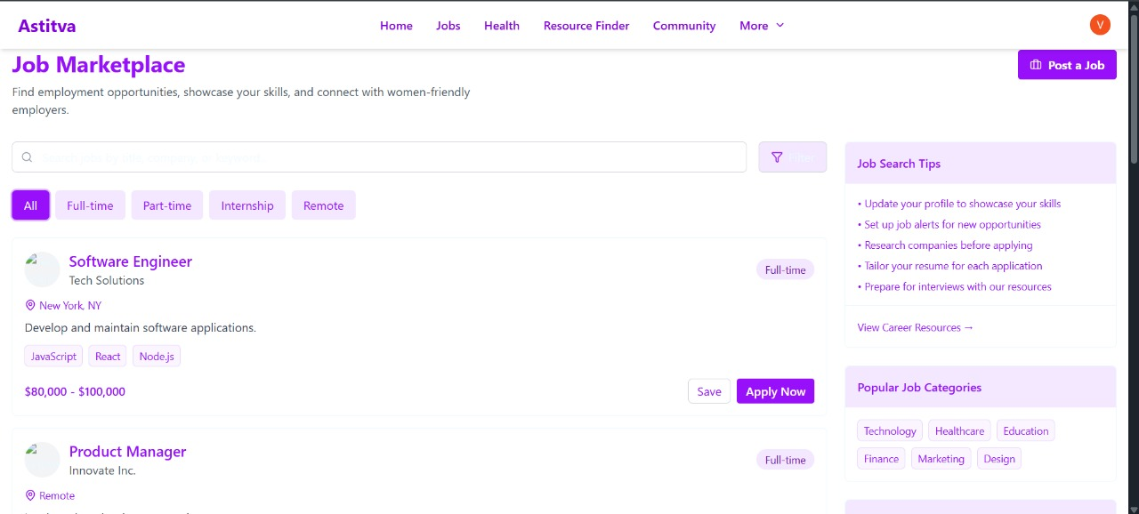
Implementation/Prototype/Use Case Diagram (screenshots)
The Job Marketplace section of Astitva is a dedicated platform for women to explore employment opportunities, showcase their skills, and connect with inclusive employers. It features:
Job Listings: Various roles, including full-time, part-time, remote, and internships.

Slide 8
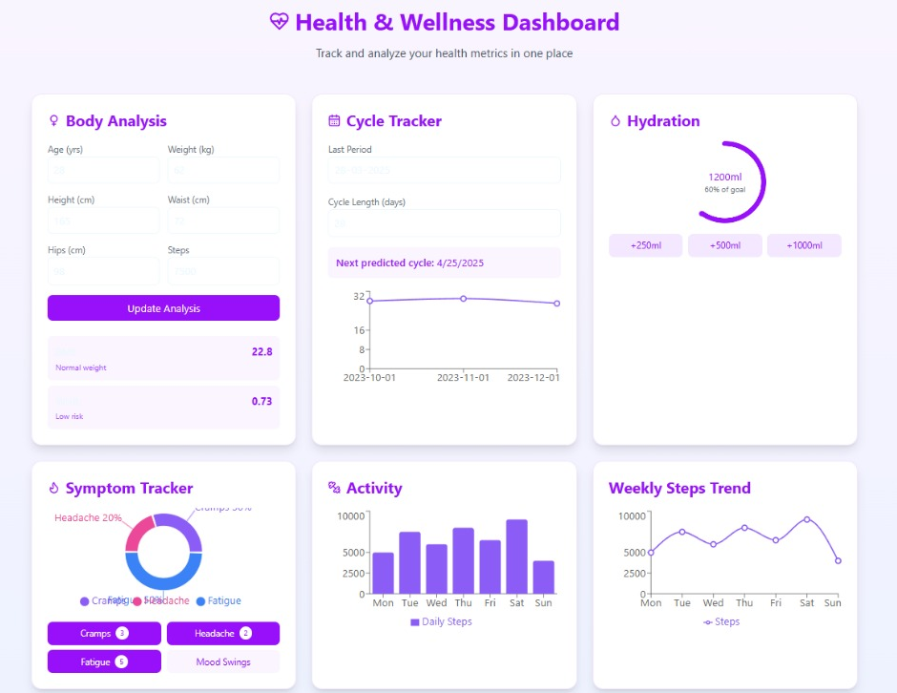
Implementation/Prototype/Use Case Diagram (screenshots)
The Health & Wellness Dashboard in Astitva helps women track key health metrics, including:
Body Analysis: BMI & health risk calculation.
Cycle Tracker: Predicts menstrual cycles.
Hydration Tracker: Monitors water intake.
Symptom Tracker: Logs cramps, headaches, fatigue, etc.
Activity & Steps Trend: Tracks daily and weekly steps.

Slide 9
Implementation/Prototype/Use Case Diagram (screenshots)
The Health & Wellness Dashboard in Astitva helps women track key health metrics, including:
Body Analysis: BMI & health risk calculation.
Cycle Tracker: Predicts menstrual cycles.
Hydration Tracker: Monitors water intake.
Symptom Tracker: Logs cramps, headaches, fatigue, etc.
Activity & Steps Trend: Tracks daily and weekly steps.

Slide 10
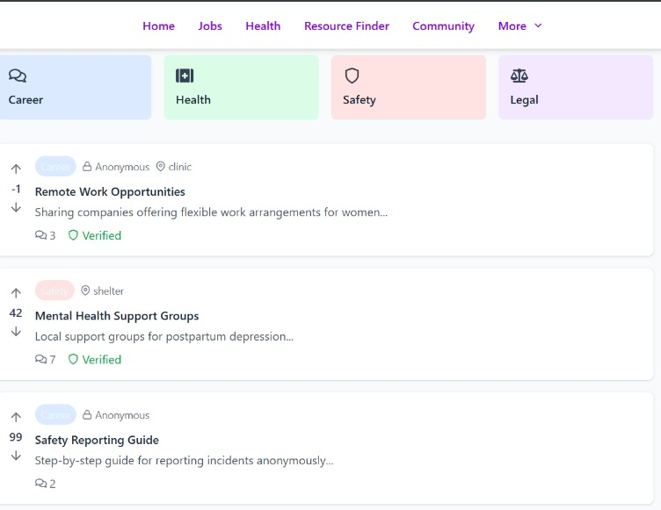
Implementation/Prototype/Use Case Diagram (screenshots)
A safe space for women to discuss and access resources under Career, Health, Safety, and Legal categories.
✔ Users can post, comment, upvote/downvote ✔ Verified posts ensure credibility ✔ Anonymous posting for privacy ✔ Resource sharing on jobs, health, and safety

Slide 11
What We Have Implemented ?
1️⃣ Job Marketplace
A platform for women-friendly job listings with search, filters, and category-based job postings
Users can apply for jobs, save listings, and access career resources.
2️⃣ Health & Wellness Dashboard
Body Analysis: BMI calculation and health risk assessment.
Cycle Tracker: Predicts menstrual cycles based on user inputs.
Hydration Tracker: Monitors daily water intake with progress indicators.
Symptom Tracker: Logs health symptoms like headaches, cramps, and fatigue.
Activity Tracker: Tracks daily and weekly steps with visualization.
3️⃣ Community & Resource Finder
Discussion forums for knowledge-sharing and networking.
Legal aid, emergency contacts, and geolocation-based safety resources.
4️⃣ Security & Authentication
Firebase authentication for secure login via email/password & Google Sign-In.
Encrypted communication for user privacy and safety.

Slide 12
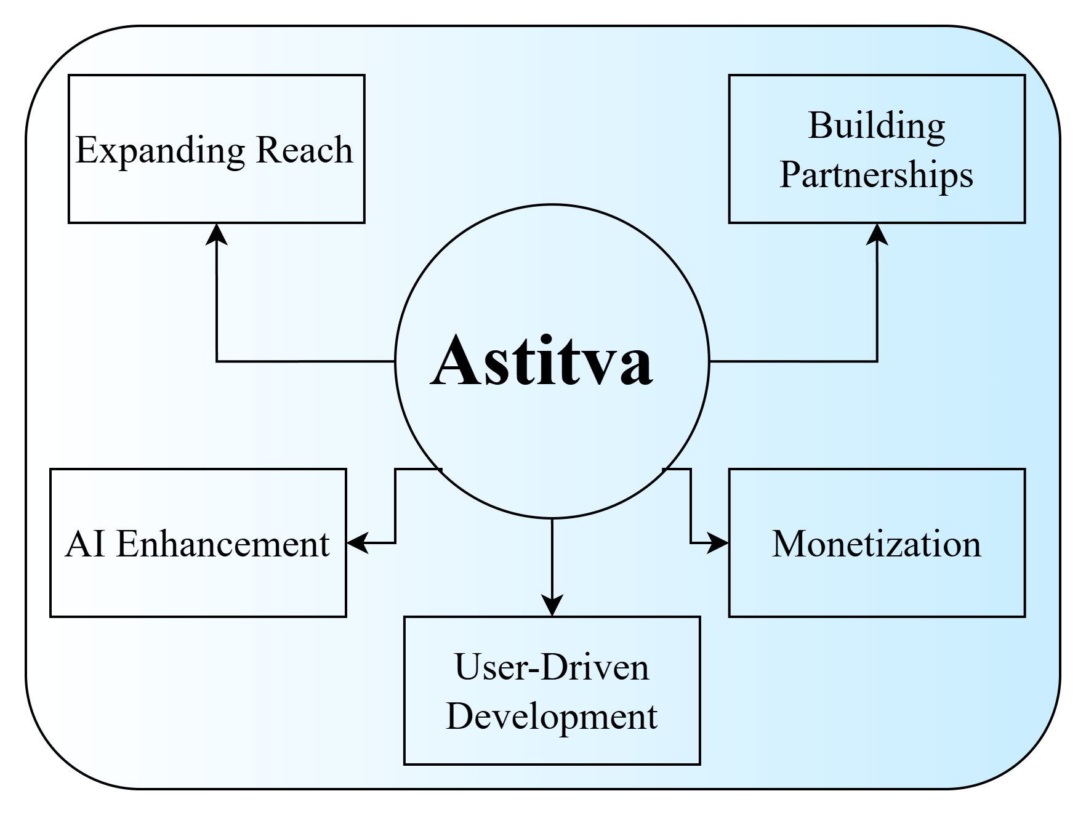
Future Objectives
1. AI & Innovation
Smarter AI support (Gemini)
Predictive safety/health alerts
2. Revenue Streams
Premium career services
NGO/government partnerships
3. Scaling Impact
Rural outreach via NGOs
Government integrations
For every woman who joins Astitva, we unlock a ripple effect—stronger families, economies, and communities.

